Slide 1
Matlab 教學2
多媒體實習 助教：王泓權

Slide 2
Some MATLAB Tips
Put each function in its own file using the same name for the file and the function. Document the function with a summary of what it does and describe each input and output argument
Convert images to floating point immediately after reading them from a file using im2single or im2double
Use imwrite to write an image to a file
imwrite(A, filename, ‘jpg’) where image A may be logical, uint8, uint16, or double. If A is double, it assumes the range of values is [0…1]

Slide 3
Some MATLAB Tips
To create an image of a figure window, use the print command
Use imshow to view a grayscale or RGB image
Use imagesc to view data
Strings use single quotes; MATLAB does not use double quotes

Slide 4
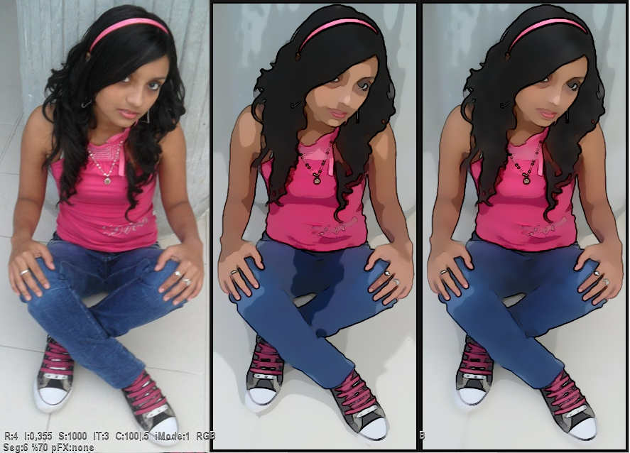
Image Filtering

Slide 5
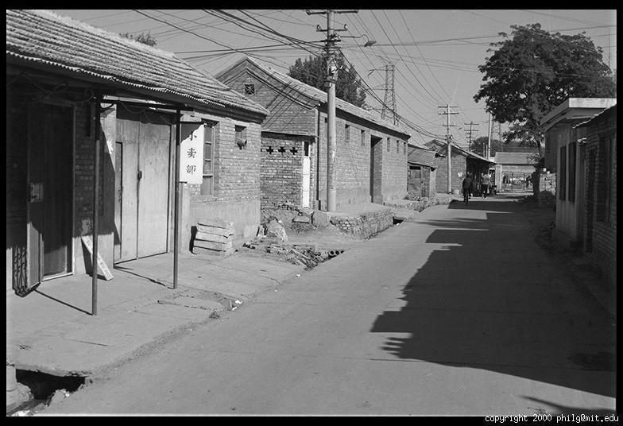
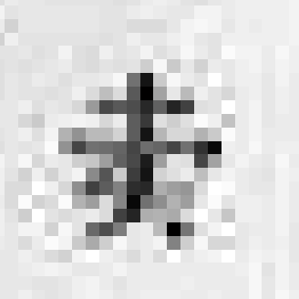
A Digital Image is a Matrix of Pixels
Source: D. Hoiem

Slide 6
A Digital Image is a Matrix of Pixels
0.92 | 0.93 | 0.94 | 0.97 | 0.62 | 0.37 | 0.85 | 0.97 | 0.93 | 0.92 | 0.99
0.95 | 0.89 | 0.82 | 0.89 | 0.56 | 0.31 | 0.75 | 0.92 | 0.81 | 0.95 | 0.91
0.89 | 0.72 | 0.51 | 0.55 | 0.51 | 0.42 | 0.57 | 0.41 | 0.49 | 0.91 | 0.92
0.96 | 0.95 | 0.88 | 0.94 | 0.56 | 0.46 | 0.91 | 0.87 | 0.90 | 0.97 | 0.95
0.71 | 0.81 | 0.81 | 0.87 | 0.57 | 0.37 | 0.80 | 0.88 | 0.89 | 0.79 | 0.85
0.49 | 0.62 | 0.60 | 0.58 | 0.50 | 0.60 | 0.58 | 0.50 | 0.61 | 0.45 | 0.33
0.86 | 0.84 | 0.74 | 0.58 | 0.51 | 0.39 | 0.73 | 0.92 | 0.91 | 0.49 | 0.74
0.96 | 0.67 | 0.54 | 0.85 | 0.48 | 0.37 | 0.88 | 0.90 | 0.94 | 0.82 | 0.93
0.69 | 0.49 | 0.56 | 0.66 | 0.43 | 0.42 | 0.77 | 0.73 | 0.71 | 0.90 | 0.99
0.79 | 0.73 | 0.90 | 0.67 | 0.33 | 0.61 | 0.69 | 0.79 | 0.73 | 0.93 | 0.97
0.91 | 0.94 | 0.89 | 0.49 | 0.41 | 0.78 | 0.78 | 0.77 | 0.89 | 0.99 | 0.93
Source: D. Hoiem

Slide 7

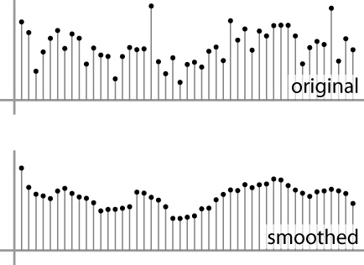
Digital Images
Sample the 2D space on a regular grid
Quantize each sample (often, 8 or 24 bits per pixel)
Image thus represented as a matrix of integer values
2D
1D
Source: S. Seitz

Slide 8
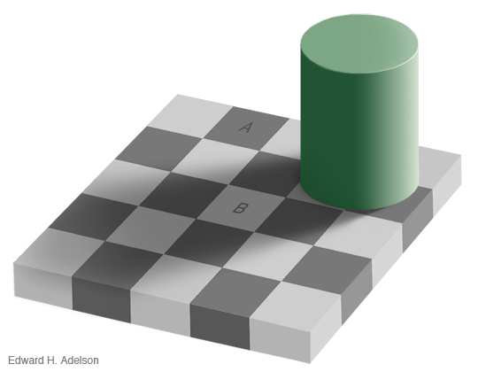
Perception of Intensity

Slide 9
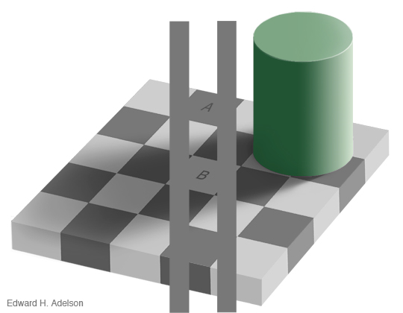
Perception of Intensity

Slide 10
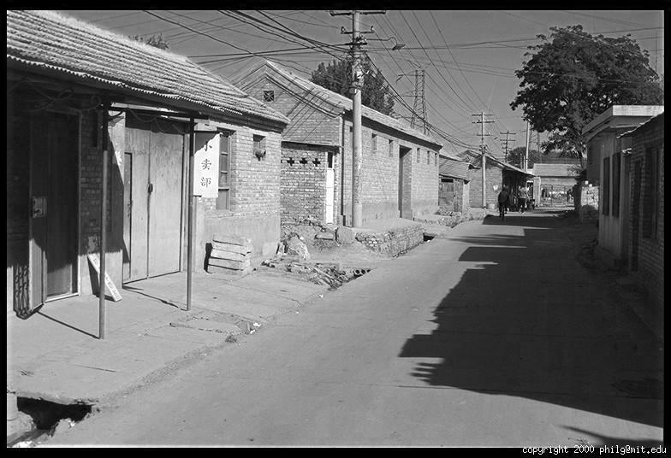
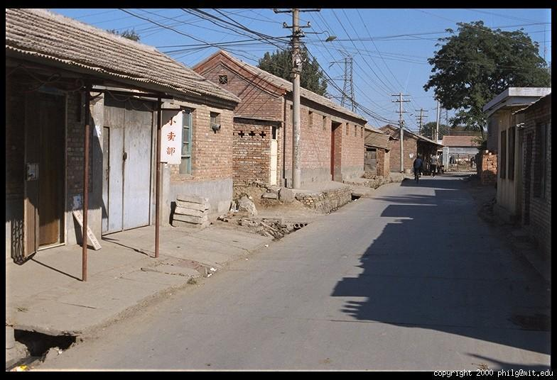
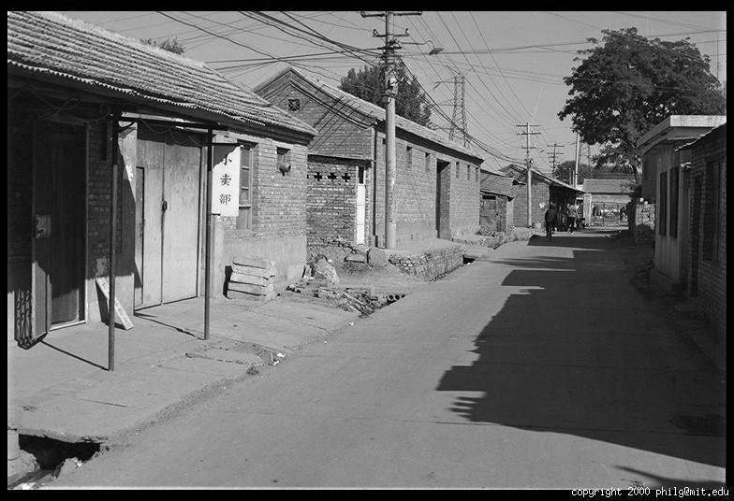
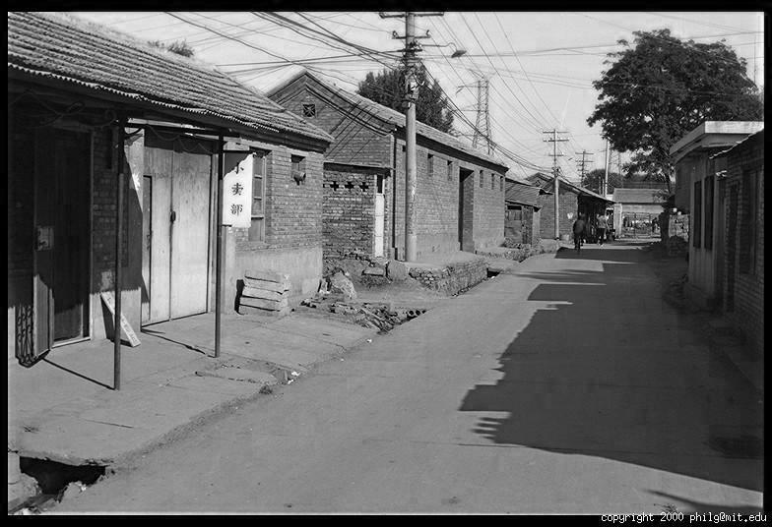
Color Image
R
G
B
Source: D. Hoiem

Slide 11
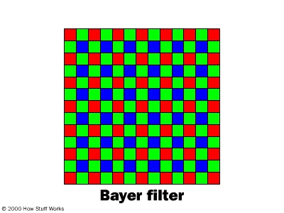
Digital Color Images
Source: D. Hoiem

Slide 12
Images in Matlab
Images represented as a matrix
Suppose we have an N x M RGB image called “im”
im(1,1,1) = top-left pixel value in R-channel
im(y, x, b) = y pixels down, x pixels to right in the b^{th} channel
im(N, M, 3) = bottom-right pixel in B-channel
imread(filename) returns a uint8 image (values 0 to 255)
Convert to double format (values 0 … 1) with im2double
column
row
R
0.92 | 0.93 | 0.94 | 0.97 | 0.62 | 0.37 | 0.85 | 0.97 | 0.93 | 0.92 | 0.99
0.95 | 0.89 | 0.82 | 0.89 | 0.56 | 0.31 | 0.75 | 0.92 | 0.81 | 0.95 | 0.91
0.89 | 0.72 | 0.51 | 0.55 | 0.51 | 0.42 | 0.57 | 0.41 | 0.49 | 0.91 | 0.92
0.96 | 0.95 | 0.88 | 0.94 | 0.56 | 0.46 | 0.91 | 0.87 | 0.90 | 0.97 | 0.95
0.71 | 0.81 | 0.81 | 0.87 | 0.57 | 0.37 | 0.80 | 0.88 | 0.89 | 0.79 | 0.85
0.49 | 0.62 | 0.60 | 0.58 | 0.50 | 0.60 | 0.58 | 0.50 | 0.61 | 0.45 | 0.33
0.86 | 0.84 | 0.74 | 0.58 | 0.51 | 0.39 | 0.73 | 0.92 | 0.91 | 0.49 | 0.74
0.96 | 0.67 | 0.54 | 0.85 | 0.48 | 0.37 | 0.88 | 0.90 | 0.94 | 0.82 | 0.93
0.69 | 0.49 | 0.56 | 0.66 | 0.43 | 0.42 | 0.77 | 0.73 | 0.71 | 0.90 | 0.99
0.79 | 0.73 | 0.90 | 0.67 | 0.33 | 0.61 | 0.69 | 0.79 | 0.73 | 0.93 | 0.97
0.91 | 0.94 | 0.89 | 0.49 | 0.41 | 0.78 | 0.78 | 0.77 | 0.89 | 0.99 | 0.93
G
0.92 | 0.93 | 0.94 | 0.97 | 0.62 | 0.37 | 0.85 | 0.97 | 0.93 | 0.92 | 0.99
0.95 | 0.89 | 0.82 | 0.89 | 0.56 | 0.31 | 0.75 | 0.92 | 0.81 | 0.95 | 0.91
0.89 | 0.72 | 0.51 | 0.55 | 0.51 | 0.42 | 0.57 | 0.41 | 0.49 | 0.91 | 0.92
0.96 | 0.95 | 0.88 | 0.94 | 0.56 | 0.46 | 0.91 | 0.87 | 0.90 | 0.97 | 0.95
0.71 | 0.81 | 0.81 | 0.87 | 0.57 | 0.37 | 0.80 | 0.88 | 0.89 | 0.79 | 0.85
0.49 | 0.62 | 0.60 | 0.58 | 0.50 | 0.60 | 0.58 | 0.50 | 0.61 | 0.45 | 0.33
0.86 | 0.84 | 0.74 | 0.58 | 0.51 | 0.39 | 0.73 | 0.92 | 0.91 | 0.49 | 0.74
0.96 | 0.67 | 0.54 | 0.85 | 0.48 | 0.37 | 0.88 | 0.90 | 0.94 | 0.82 | 0.93
0.69 | 0.49 | 0.56 | 0.66 | 0.43 | 0.42 | 0.77 | 0.73 | 0.71 | 0.90 | 0.99
0.79 | 0.73 | 0.90 | 0.67 | 0.33 | 0.61 | 0.69 | 0.79 | 0.73 | 0.93 | 0.97
0.91 | 0.94 | 0.89 | 0.49 | 0.41 | 0.78 | 0.78 | 0.77 | 0.89 | 0.99 | 0.93
B
0.92 | 0.93 | 0.94 | 0.97 | 0.62 | 0.37 | 0.85 | 0.97 | 0.93 | 0.92 | 0.99
0.95 | 0.89 | 0.82 | 0.89 | 0.56 | 0.31 | 0.75 | 0.92 | 0.81 | 0.95 | 0.91
0.89 | 0.72 | 0.51 | 0.55 | 0.51 | 0.42 | 0.57 | 0.41 | 0.49 | 0.91 | 0.92
0.96 | 0.95 | 0.88 | 0.94 | 0.56 | 0.46 | 0.91 | 0.87 | 0.90 | 0.97 | 0.95
0.71 | 0.81 | 0.81 | 0.87 | 0.57 | 0.37 | 0.80 | 0.88 | 0.89 | 0.79 | 0.85
0.49 | 0.62 | 0.60 | 0.58 | 0.50 | 0.60 | 0.58 | 0.50 | 0.61 | 0.45 | 0.33
0.86 | 0.84 | 0.74 | 0.58 | 0.51 | 0.39 | 0.73 | 0.92 | 0.91 | 0.49 | 0.74
0.96 | 0.67 | 0.54 | 0.85 | 0.48 | 0.37 | 0.88 | 0.90 | 0.94 | 0.82 | 0.93
0.69 | 0.49 | 0.56 | 0.66 | 0.43 | 0.42 | 0.77 | 0.73 | 0.71 | 0.90 | 0.99
0.79 | 0.73 | 0.90 | 0.67 | 0.33 | 0.61 | 0.69 | 0.79 | 0.73 | 0.93 | 0.97
0.91 | 0.94 | 0.89 | 0.49 | 0.41 | 0.78 | 0.78 | 0.77 | 0.89 | 0.99 | 0.93

Slide 13

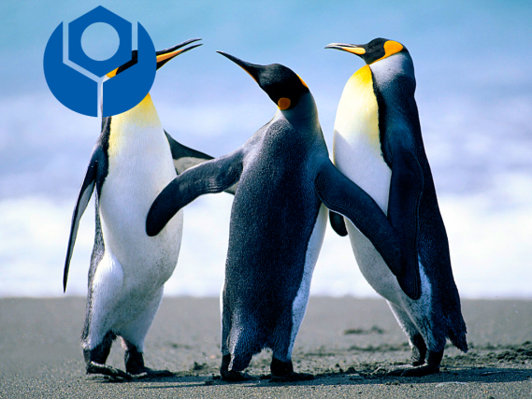


exp07
給四張有物體遮擋的圖片，從裡面選三張圖片，將真實的圖片還原回來。

